Slide 1
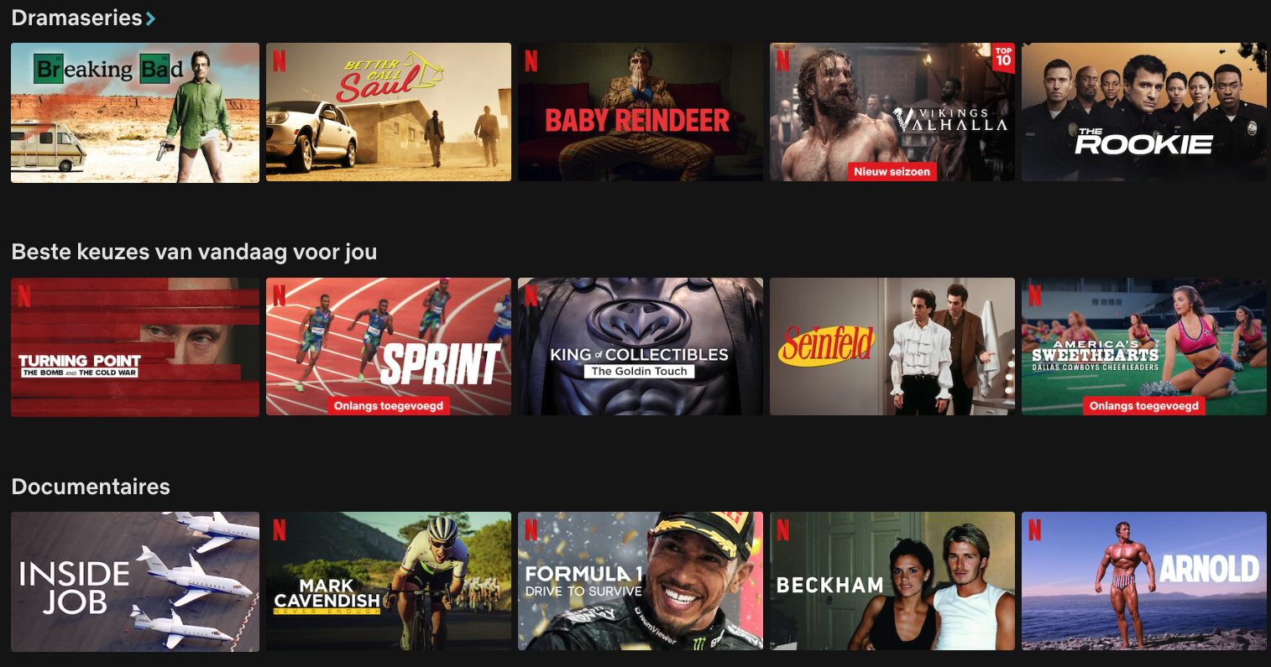
Recommender Systems

Slide 2
Contents
Recommender Systems
How do they work?
Content-based methods
Collaborative Filtering
  Item-to-item
  User-to-user
Motivation: Netflix Challenge
Matrix Factorisation

Slide 3
Recommender Systems
Systems that can estimate, for any user u and item i the degree of interest/satisfaction/importance of u in i
The estimation is based on historical rating, purchase, browsing, etc. data
Examples:
  Amazon.com: recommend books
  Netflix: recommend movies
  iTunes: recommend songs, albums, artists
  booking.com, Tripadvisor, Spotify, ….

Slide 4

Recommendation is Everywhere

Slide 5

Recommendation is Everywhere

Slide 6
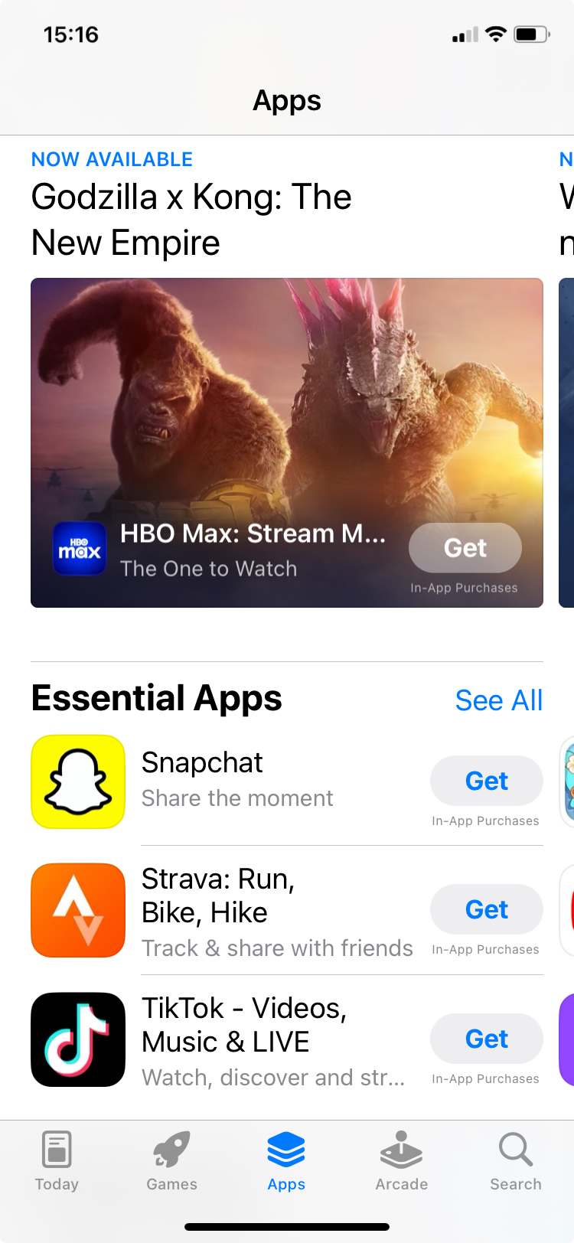
Recommendation is Everywhere

Slide 7
Recommender Systems: How do they Work?
Content-based recommenders
  Memory-based
  Model-based
Collaborative Filtering
  K-Nearest-Neighbours
    Item-to-item
    User-to-user
  Matrix Factorization

Slide 8
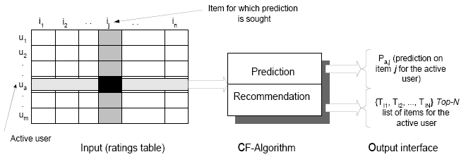
Common Scenario: Estimate R(User, Item)
A matrix: Users x Items partially filled with
  ratings (how users rated items)
  interest (how much browsing time)
  purchase history (0 or 1)
  …
Usually huge: millions of users x thousands of items
Usually sparse: most entries missing. (In practice different datastructure)

Slide 9
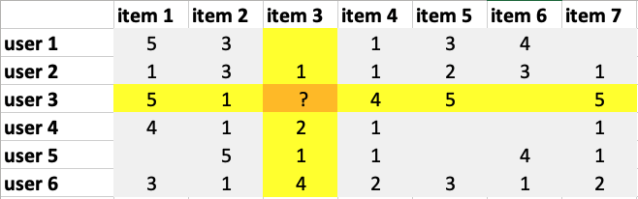
Naive Approach
R_{global}(u, i) = mean(all ratings)
R_{item}(u, i) = mean(all ratings for i)
R_{user}(u, i) = mean(all ratings for u)
R_{user-item}(u, i) = α･R_{user}(u, i) + β･R_{item}(u, i) + γ
(parameters α, β, γ estimated with Linear Regression)
R_{user*-item}(u, i) = α･R_{user}(u, i) + β_{user}･R_{item}(u, i)
...
R_{user}(u, i)
R_{item}(u, i)

Slide 10
Naive Approach
Naive approach works surprisingly well
Models very easy to calculate and to maintain
Simple interpretation of the models:
  ‘good movie’
  ‘harsh user’
  ‘crowd follower’
  ...

Slide 11
Content-Based Approach
Construct for every item its profile –
a vector (or set) of features that characterize the item
Construct for every user his/her profile –
an ‘average’ profile of the items they like
Recommend items that are closest to the user profile
Closeness: Jaccard, cosine, Pearson, … distance

Slide 12
Example Item Profiles
Movies:
  Genre
  Director
  Movie Stars
  Production Year
Scientific Articles:
  Important words (high TF.IDF values)
  Journal title
  Author(s)
  Institution
Music:
  Instruments
  …

Slide 13
Model-based Approach
Once we have item profiles, we can train, per user, a classification or regression model which predicts rating from the item profile:
  Model: a decision tree, neural network, SVM
  Input: item profile
  Output: user ratings
Expensive to build and maintain; low accuracy;
what about new users (cold-start problem)?

Slide 14
Collaborative Filtering
Recommends items to the user based on what other similar users have liked
Users that rate items in a similar way
How to find other user’s preferences? From data
User-User CF
Item-Item CF

Slide 15
User-User Recommendations
Each user is represented by a vector that contains ratings for each product they bought/rated
Users with ‘similar’ rating vectors are similar
How do we measure similarity of vectors?

Slide 16
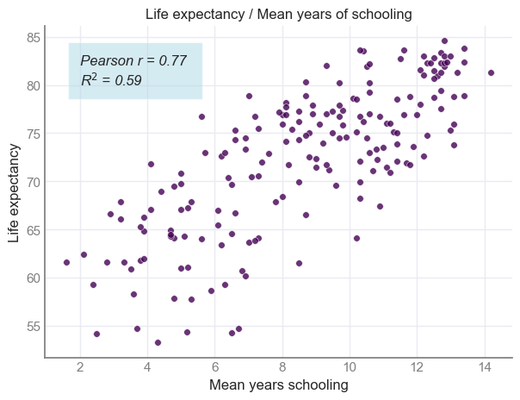
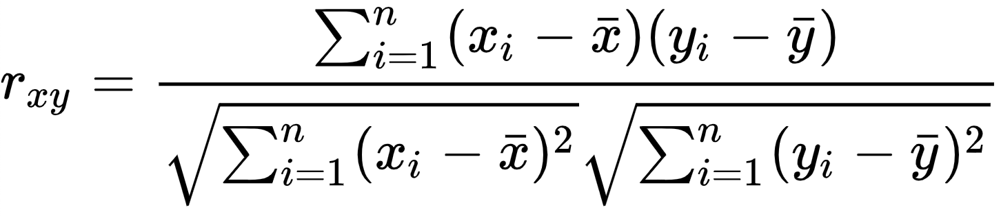
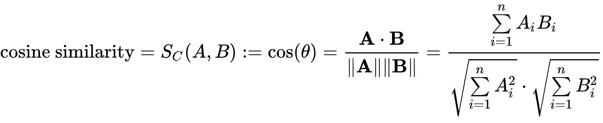
Find Nearest Neighbours
Step 1. Calculate similarity between vectors
  Pearson correlation:
  Cosine similarity:
  Jaccard similarity
    applies to 0/1 data
S_{C}(A, B) = 3.5/(1.4･2.25) = 0.98

Slide 17
Find Nearest Neighbours
Step 2. Define neighbourhood (size L)
  compute similarity
  sort and take first L
  (thresholding to get neighbourhood)
  aggregate scores of neighbourhood
  (e.g., take a weighted average rating)

Slide 18
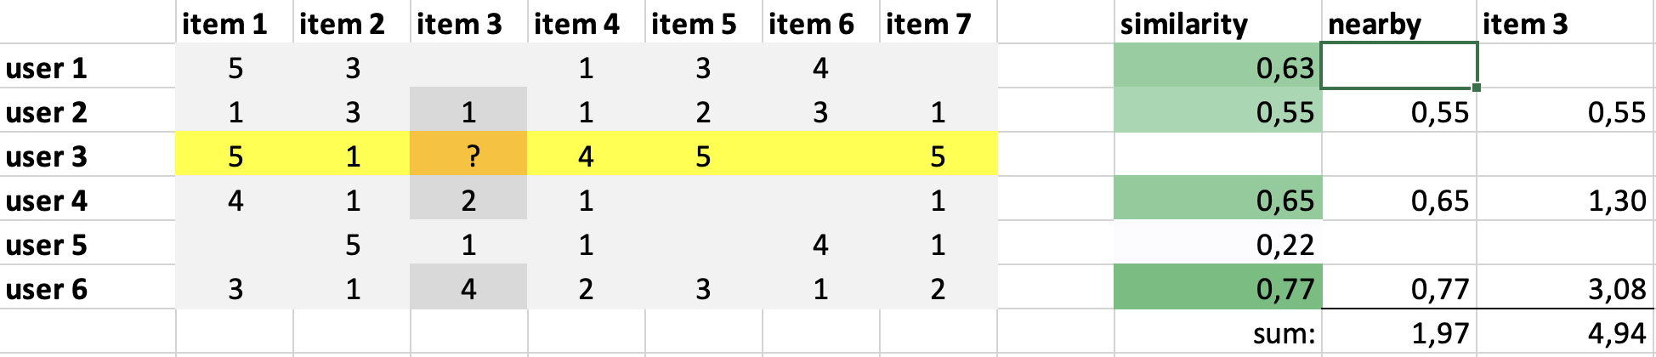
User-User Collaborative Filtering
Cosine similarity
between user u
and user 3

Slide 19
User-User Collaborative Filtering
no weight, since no rating
weight

Slide 20
User-User Collaborative Filtering
score
weight
weighted
score per user

Slide 21
User-User Collaborative Filtering
R(u₃, i₃) = 4.94/1.97 = 2.5

Slide 22
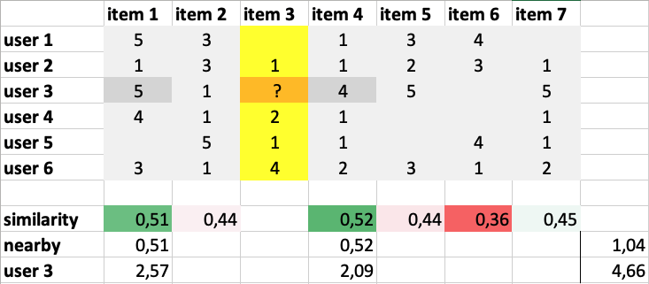
Item-Item Collaborative Filtering

Slide 23
Item-Item Collaborative Filtering
Cosine similarity
between item i
and item 3

Slide 24
Item-Item Collaborative Filtering
weights and
weighted score

Slide 25
Item-Item Collaborative Filtering
R(u₃, i₃) = 4.66/1.04 = 4.5

Slide 26
User-User and Item-Item
User-User CF recommends items to a user based on the preferences of similar users. It assumes that users who have agreed in the past will agree in the future
Item-Item CF recommends items to a user based on the similarity between items.
It assumes that if a user likes a particular item, they will like similar items
Feature | User-User CF | Item-Item CF
Basis for Recommendations | Similarity between users | Similarity between items
Scalability | Less scalable with large user bases | More scalable with large item bases
Data Sparsity | Can be problematic | Less problematic
Cold Start Problem | New users pose a challenge | New items pose a challenge
Personalization | High personalization | Less personalization
Stability | May fluctuate with user behavior | More stable over time

Slide 27
Collaborative Filtering: Summary
Three steps:
  Represent data: rating/utility matrix
  Define neighbourhood: cosine, Pearson correlation, Jaccard, ...
  Make predictions or recommendations: weighting scheme
Advantages:
  can recommend items that are not linked to the user’s earlier choices
  (useful for promotions)
  considers the opinions of a wide spectrum of users
Limitations:
  Sparsity of data
  Individual characteristics are not taken into account
  Tends to recommend popular items (convergence around few items)
  Computationally very expensive (time & memory)
Notes:
Collaborative filtering: summary

Slide 28
break

Slide 29
Netflix Challenge & Matrix Factorisation

Slide 30
Netflix Now and Then

Slide 31
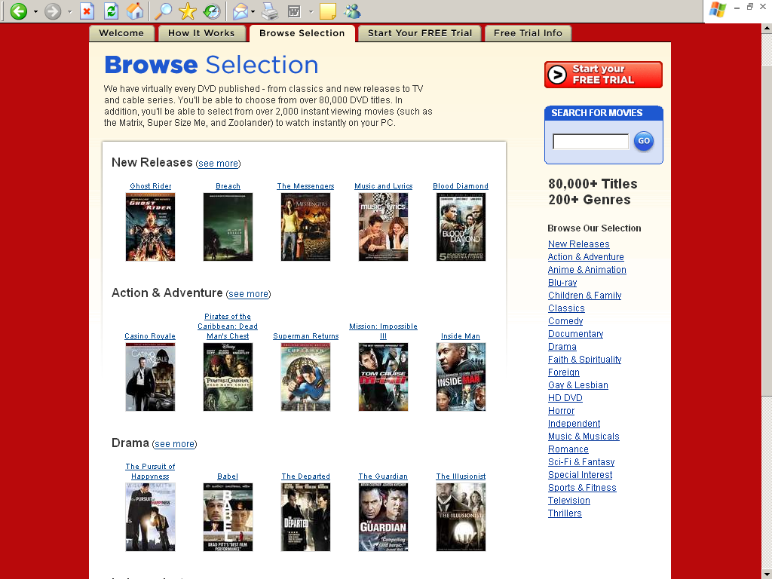
Netflix Now and Then

Slide 33
What is NETFLIX (in 2006)?
Biggest on-line DVD movie rental company:
  5 million active customers
  80.000 movies to choose from
  ship 2 million disks per day
How do people choose from 80.000 movies?
  Get feedback: 3 million ratings per day
  Analyze data and predict preferences:
  1 billion predictions per day
  The CINEMATCH system: state-of-the-art (in 2006)

Slide 34
NETFLIX (2006) expected in 2010-2012
20 million subscribers (x4)
receive 10 million ratings a day
generate 5 billion predictions per day
Movies distributed via Internet
Accuracy of predictions is crucial for maintaining competitive advantage!
➔ Announce a $1.000.000 CHALLENGE

Slide 35
The Netflix Challenge
$ 1.000.000 Grand Prize for a data miner who will improve the accuracy of Netflix recommendation system by 10%
Each year $ 50.000 Progress Prize
for yearly best submission (> 1% over last year)
Started in October 2006
To be finished in or before October 2011

Slide 36
The Netflix Challenge
100.000.000 rating records collected over 1997-2005
rating record:
<customer_id, movie_id, date, rating>
500.000 customers
18.000 movies
rating = an integer: 1, 2, 3, 4 or 5
Additionally, 3.000.000 test records:
<customer_id, movie_id, date, ? >
Goal: fill in ?’s with numbers, so the error is minimized

Slide 37
Submission Validation
RMSE (Root Mean Squared Error)
Naive prediction (average grade of movie): RMSE = 1.0540 (stars)
Netflix baseline: RMSE = 0.9514 (Cinematch)
1% improvement: RMSE = 0.9419
5% improvement: RMSE = 0.9038
10% improvement: RMSE = 0.8563

Slide 38
Participation
45.000+ participants
37.000+ teams
36.000+ valid submissions from 4200 teams (!)
about 50-100 submissions per day
World-wide press coverage
Netflix Forum, conferences, workshops, special issues of journals, etc.
  ➔ Immense boost of research on Recommender Systems

Slide 39
The Winner is …
October, 2006: Start of the Competition
After 7 days: Netflix base-line reached
(0% improvement)
After 42 days: 5% improvement
January 2007: 6% improvement
May 2007: 7% improvement
October 2007: 8.46% ($50.000 Prize, AT&T Team)
October 2008: 9.44% (AT&T + BigChaos)
July 2009: 10.06% (several teams of teams) 🎉

Slide 40
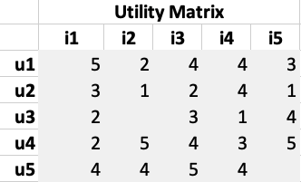
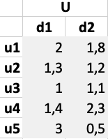
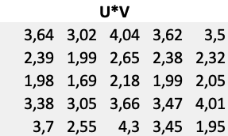
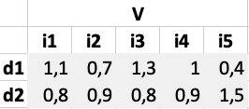
Matrix Factorisation
Look at the data from both perspectives
(users and items) at the same time!
Assume that each user and each movie can be represented by a fixed-length vector of ‘features’ that characterize them:
user vector and item vector (e.g., of length 20)
u v
Assume that each rating can be approximated by a product of corresponding vectors:
rating=sum(user vector x item vector)
u^{T}･v
Find optimal values of all feature vectors that minimize MSE
d1: “prefers romantic comedies vs action”
d2: “tendency toward niche indie vs blockbuster mainstream”
⨉
=
factorisation
compute squared errror

Slide 41
Minimize Error Function
Error function is a polynomial of many (50 million?) unknowns:
f(u₁, …, u_{m}, v₁, …, v_{n}) = sum((r_{ij} - u_{i}v_{j}')²)
Find a minimum of this function with help of any optimization method
  simple line search
  Gradient Descent
  Alternating Least Squares

Slide 42
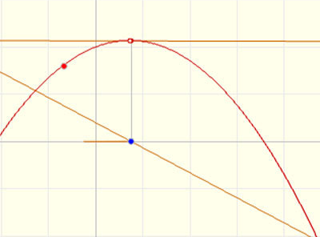
Simple Line Search
(Chapter 9 of the MMDS book)
Initialize all variables at random
Continue till convergence:
  choose one random parameter
  freeze all other parameters
  then f(…, x, …) is a function of one variable
  actually, f(…, x, …) is a quadratic function of x
  find the optimal value for x
  repeat
f
0
f’

Slide 43
Gradient Descent Algorithm
How to find a minimum of a function f(x, y) ?
Start with an arbitrary point (x₀, y₀)
Find a direction in which f is decreasing most rapidly:
Make a small step in this direction:
Repeat the whole process

Slide 44
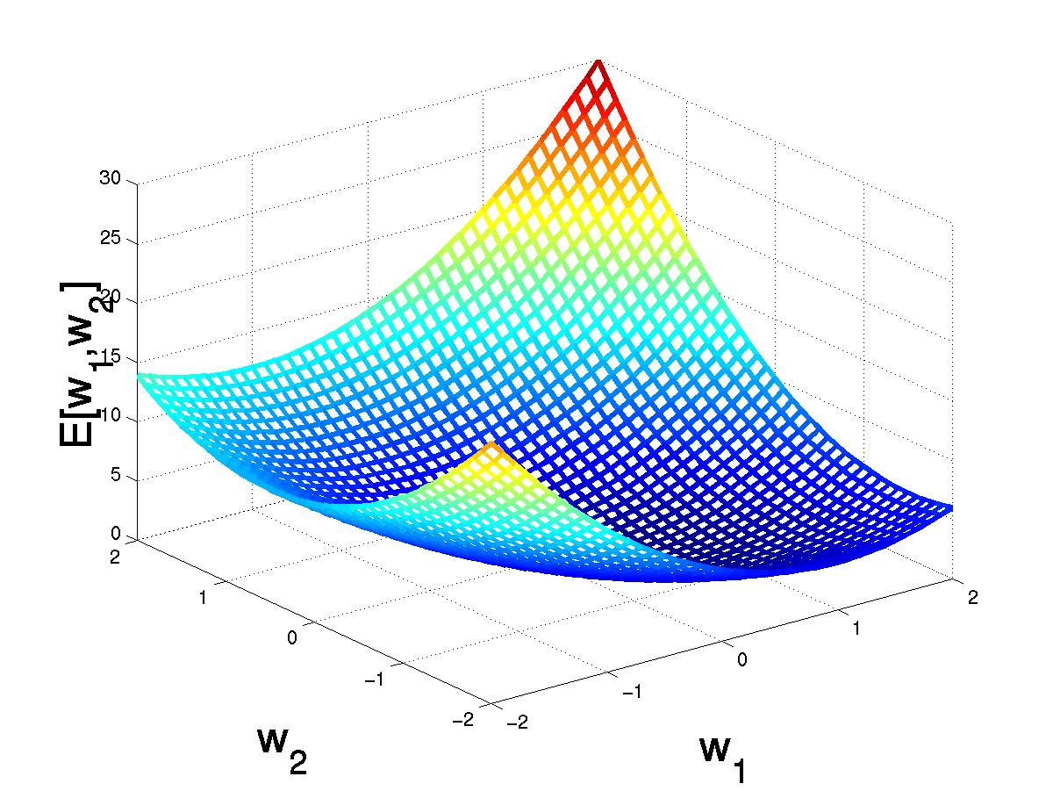
Gradient Descent
E(w₁, w₂)
E(w₁+Δw₁, w₂ +Δw₂)

Slide 45
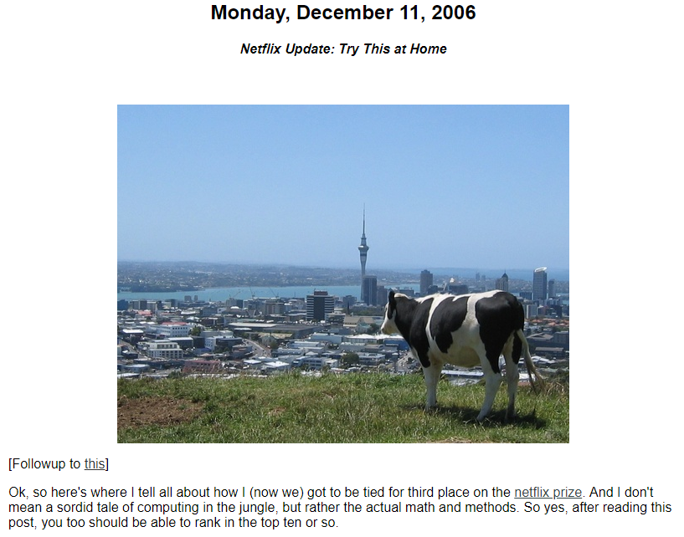
SGD Matrix Factorisation:
Simon Funk’s Submission
After 2 months
~5% improvement, top three at the time
https://sifter.org/~simon/journal/20061211.html

Slide 46
Simon Funk’s Trick
Introduce about 50M unknowns (200MB):
100 unknowns for each user : userFeature[f][user]
100 unknowns for each movie: movieFeature[f][movie]
Assume that predictions can be approximated by the dot products of these unknowns:
ratingPredicted[user][movie] =
sum(userFeature[f][user] * movieFeature[f][movie])
Define the error (err) as a function of all unknowns:
sum((ratingPredicted[user][movie] - ratingTrue[user][movie])^2)
Find the minimum with gradient descent delta-rule:
userValue[user] += lrate * err * movieValue[movie]
movieValue[movie] += lrate * err * userValue[user]
dot product of two vectors
nudge the user vector in the direction of the movie vector
and
nudge the movie vector in the direction of the user vector

Slide 47
Iterative Stochastic Gradient Descent
Initialize all variables at random
Iterate over all records (user, item, rating):
  estimate the direction of steepest descent of function f (i.e., find a vector of partial derivatives)
  make a step of size η in this direction (learning rate)
till convergence or a stop criterion is met
Iterate:
err = rating – u_{user}・v_{item}
u_{user} = u_{user} + η・err・v_{item}
v_{item} = v_{item} + η・err・u_{user}
until convergence
The gradient is estimated with each update, from only a single (u, i, r) record
The process is stochastic since records are processed in random order
η = 0.001 or similar

Slide 48
Regularisation
The initial implementation by Funk is prone to overfitting
For extreme movies/users, the values may become quite extreme
Large values in U may be compensated with small values in V, and vice versa
Solution: regularisation
  add a small penalty on large values
u_{user} = u_{user} + η・(err・v_{item} − λ・u_{user})
v_{item} = v_{item} + η・(err・u_{user} − λ・u_{item})
Regularized SGD-MF works better on unseen data
λ = 0.01 or similar

Slide 49
Alternating Least Squares
Alternative to Stochastic Gradient Descent
  Initialize all variables at random
  Repeat:
    Freeze the user features and treat all item features as variables
    Solve the resulting Least Squares Problem
    Freeze the item features and unfreeze the user features
    Solve the resulting Least Squares Problem
  until convergence
Attractive parallelisation properties

Slide 50
Interpretation of dimensions
Dimension 1
Dimension 2

Slide 51
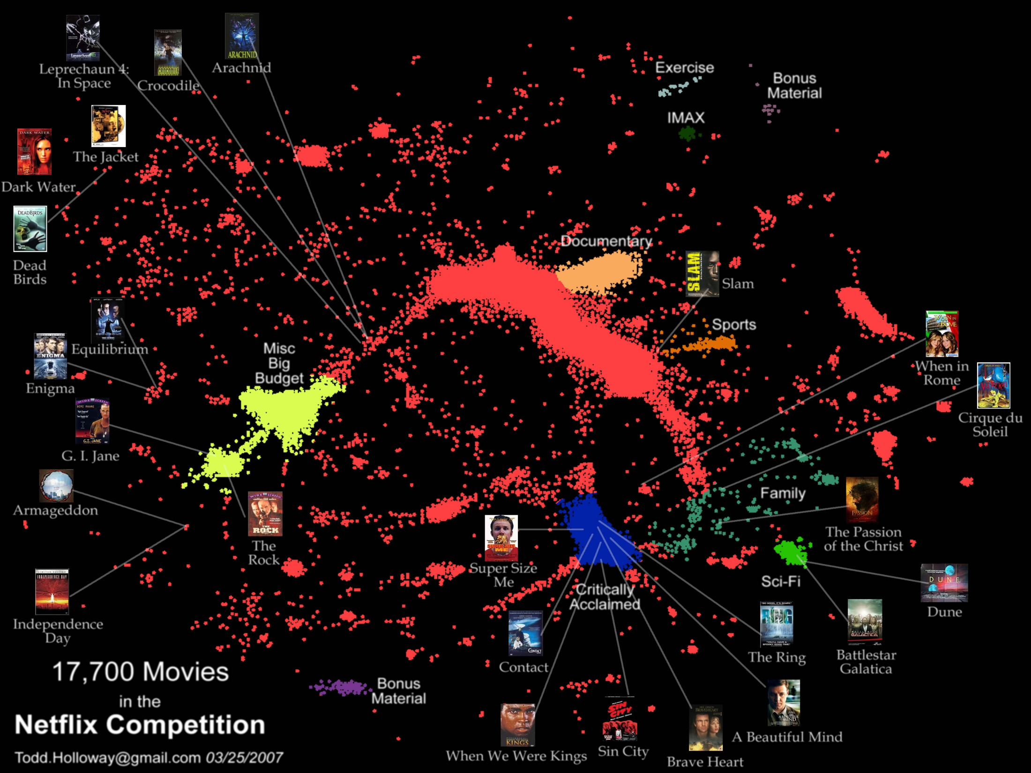

Slide 52
Boosting Accuracy: Blending Models
Main idea:
Build many models with help of several techniques, on various samples of data and blend the predictions
Blending: applying linear regression to find optimal coefficients of a linear combination of models
Winning submissions used combinations of 100-200 models, built with 3-5 main algorithms
Combining models of different types (e.g., SVD, kNN, RBM) is very beneficial!

Slide 53
Links …
More references:
https://en.wikipedia.org/wiki/Netflix_Prize
Simon Funk approach:
http://sifter.org/~simon/journal/20061211.html
Netflix Workshop KDD2007:
http://www.cs.uic.edu/~liub/KDD-cup-2007/proceedings.html

